Slide 1

Capstone Project
Exploring
Coffee Quality

Slide 2

Project overview :
The primary objective of this project is to conduct a comprehensive analysis to understand the factors that contribute to coffee quality and improve overall quality of coffee.
By systematically evaluating various parameters such as flavour, aroma, Body, consistency etc,. The project aims to identify key factors influencing coffee quality.
This analysis will provide insights into optimizing variety of coffees, processing Methods etc., and meeting consumer expectations more effectively.

Slide 3
Objectives & constraints
The Coffee Quality Institute (CQI) is a non-profit organization that works to improve the quality and value of coffee worldwide. It was founded in 1996 and has its headquarters in California USA.
CQI's mission is to promote coffee quality through a range of activities that include research, training, and certification programs.
The organization works with coffee growers, processors, roasters, and other stakeholders to improve coffee quality standards, promote sustainability, and support the development of the specialty coffee industry.

Slide 4

Objectives:
1 To identify the key determinants of coffee quality as evaluated through sensory attributes such as aroma, flavour, and acidity.
2 To explore the correlation between processing methods, origin regions, and coffee quality scores.
3 To identify trends or patterns in defect occurrences and their impact on overall coffee quality.
4To analyze how different variables interact to influence the Total Cup Points, an overall measure of coffee quality.

Slide 5
Technical Stacks :
Power Bi
Microsoft Excel
Microsoft Power Point

Slide 6
Project Architecture :
Business Understanding
Data Understanding
Data Collection
EDA
Data Pre-processing
Data Modelling
Data Visualization
Publish

Slide 7
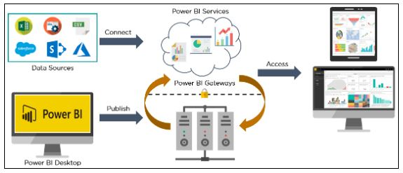
Power Bi Architecture

Slide 8
Table of Contents
EDA
Data Preprocessing & Feature Scaling
Data Modelling
Visulaization
Insights
Suggestions for Future Research
Conclusion

Slide 9

Exploratory Data Analysis

Slide 10

Coffee is one of the most popular beverages in the world, made from roasted coffee beans, which are the seeds of the Coffee plant. It is known for its rich aroma, bold flavour, and stimulating effect due to caffeine. The journey of coffee begins with cultivation in tropical regions, followed by harvesting, processing, roasting, and brewing. There are various types of coffee, including espresso, cappuccino, and cold brew, each with unique preparation methods. Beyond its taste, coffee plays a significant role in culture, social interactions, and even the global economy.

Slide 11
Data
The data includes a range of information an coffee production, processing and sensory evaluation. It also Contains data on coffee genetics, soil types and other factors that can affect coffee quality.

Slide 12
Sensory Attributes | Characteristics | Varieties
Aroma | Fragrance and scent of coffee | Floral, Fruity, Nutty, Spicy
Flavour | Overall taste profile | Chocolatey, Caramel, Fruity, Nutty
Aftertaste | Lingering taste after sipping | Smooth, Bitter, Sweet, Rich
Acidity | Brightness & liveliness of flavor | Citric, Malic, Phosphoric, Tartaric
Body | Thickness & mouthfeel | Light, Medium, Heavy
Balance | Harmony between attributes | Well-balanced, Complex, Simple
Uniformity | Consistency across cups | Consistent, Inconsistent
Clean Cup | Absence of defects/off-flavors | Clean, Earthy, Musty
Sweetness | Natural sugars in coffee | Caramel-like, Fruity, Floral

Slide 13

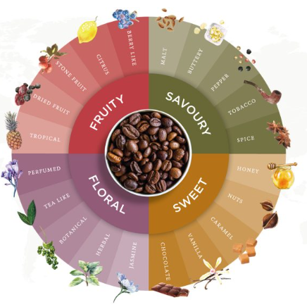
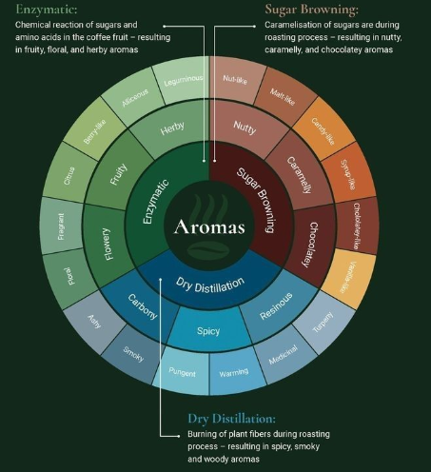
Flavour & Aroma

Slide 14
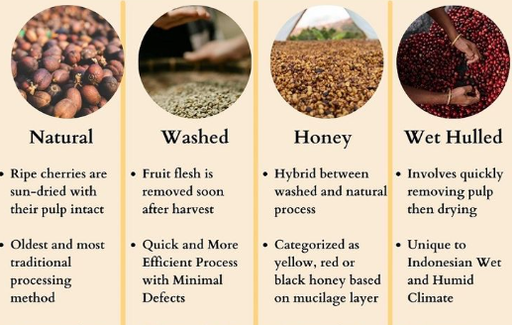
Coffee Processing Methods

Slide 15
Other Attributes:
ID: A unique identifier assigned to each coffee lot for tracking and reference.
Country: The nation where the coffee is cultivated, influencing its flavour profile due to regional growing conditions.
Lot Number: A specific code assigned to a batch of coffee beans, aiding in traceability and quality control.
Altitude: The elevation at which coffee is grown; higher altitudes often result in beans with greater acidity and complex flavours.
Region: The specific area within a country where the coffee is produced, contributing distinct characteristics to the beans.
Number of Bags: The total count of coffee bags in a particular lot, indicating the batch size.
Bag Weight: The weight of an individual coffee bag, typically measured in kilograms or pounds.
In-Country Partner: Local organizations or individuals collaborating in the production or export of the coffee.
Variety: The specific subspecies or cultivar of the coffee plant, such as Bourbon affecting taste and quality.
Status: The current condition or classification of the coffee lot, such as 'pending grading' or 'ready for export’. Grading Date: The date on which the coffee was evaluated for quality, determining its grade and market value.
Grading Date: The date on which the coffee was evaluated for quality, determining its grade and market value.

Slide 16
Other Attributes:
.Moisture Percentage: The amount of moisture in the beans; optimal levels are crucial for preserving quality and preventing mold.
Quakers: Underripe or defective beans that remain pale after roasting, negatively impacting flavor.
Color: The appearance of the beans, which can indicate processing methods and potential defects.
Total Cup Points: A score reflecting the overall sensory quality of the coffee, based on factors like aroma, flavor, and body.
Harvest Year: The year in which the coffee cherries were harvested, affecting freshness and flavor.
Expiration: The date by which the coffee is best consumed to maintain optimal quality.
Defects: Flaws in the beans, such as insect damage or fermentation issues, that can degrade the coffee's quality.
Category One defects; These are primary defects that can be perceived through visual inspection of the coffee beans. These defects include Black beans, sour beans, insect-damaged beans, fungus-damaged beans, etc.
Category Two defects ; These are secondary defects that are more subtle and can only be detected through tasting. These defects include Over-fermentation, staleness, rancidness, chemical taste, etc.

Slide 17


Data Preprocessing & Feature Scaling

Slide 18
Data Preprocessing in Power Query Editor:
Country of Origin – Renamed the column to country for consistency.
Lot Number – Filled down null values and translated Chinese to English.
Altitude – Split into twice & created 3 columns, one delimiter column deleted, converted data type to number - only one blank in altitude.1, replaced blank to null, 1blank filled with fill down. – data type to whole number for both columns. - created a new column with condition calculating average of range, if there is a range in altitude.
Region - Removed empty rows, reducing the dataset from 207 rows to 205. Translated Chinese text into English for consistency.
Number of Bags – No changes required.
Bag Weight - Extracted kg from weight values and converted them to whole numbers.

Slide 19
Data Preprocessing in Power Query Editor:
Country Partner - Translated Chinese text to English.
Grading Date – Removed st, th, rd, nd with space, corrected “Augu” to “August” and changed the data type to Date.
Variety - Replace blanks with null, fill down the null, also there were unknown & unknown rows , but from country Taiwan only.
Processing Method- Replaced blanks with null, fill down the null.
Color - Corrected text inconsistencies.
Expiration Date – Fixed text errors and changed the data type of Date.
All remaining columns – Verified as clean, with no errors.

Slide 20
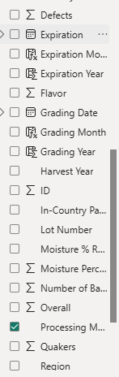
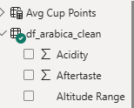
Feature Scaling :
New column Added
Altitude Range
Moisture Range
Grading Month
Grading Year
Expiration Year
Expiration Month

Slide 21
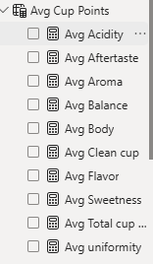
Feature Scaling :
Avg Cup Points- New Table Added :
New Measures Added
Avg _Aroma
Avg_- Acidity
Avg -AfterTaste
Avg_ Flavour
Avg _Body
Avg __Balance
Avg _Uniformity
Avg _Sweetness
Avg _Cleanup

Slide 22


Slide 23
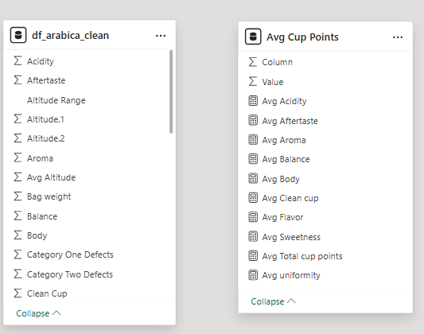

Slide 24
Visualization
Feature Analysis with Visualization

Slide 25
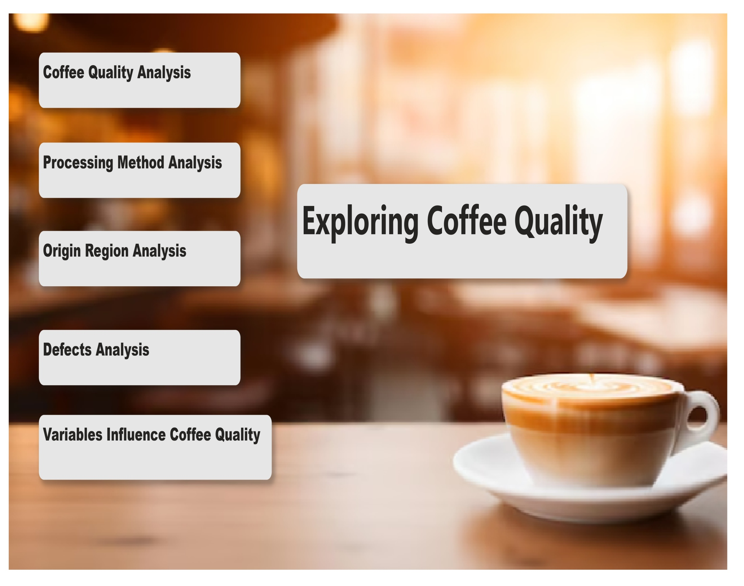

Slide 26
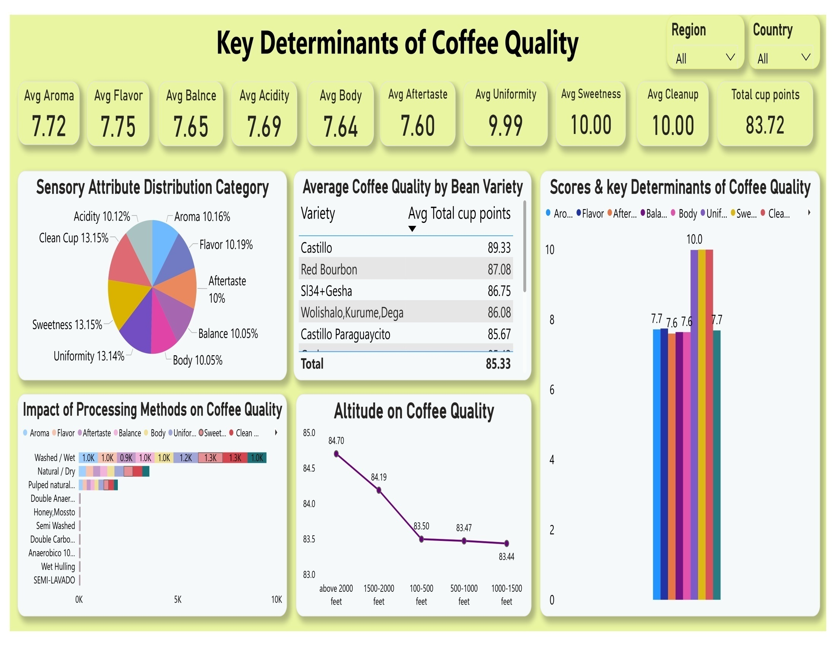

Slide 27
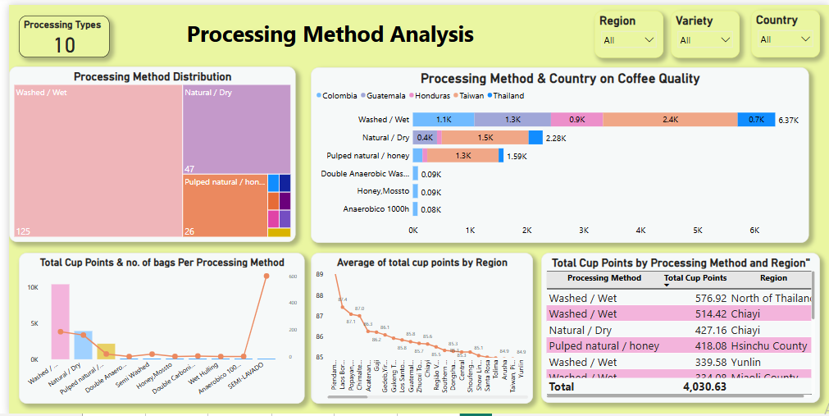

Slide 28
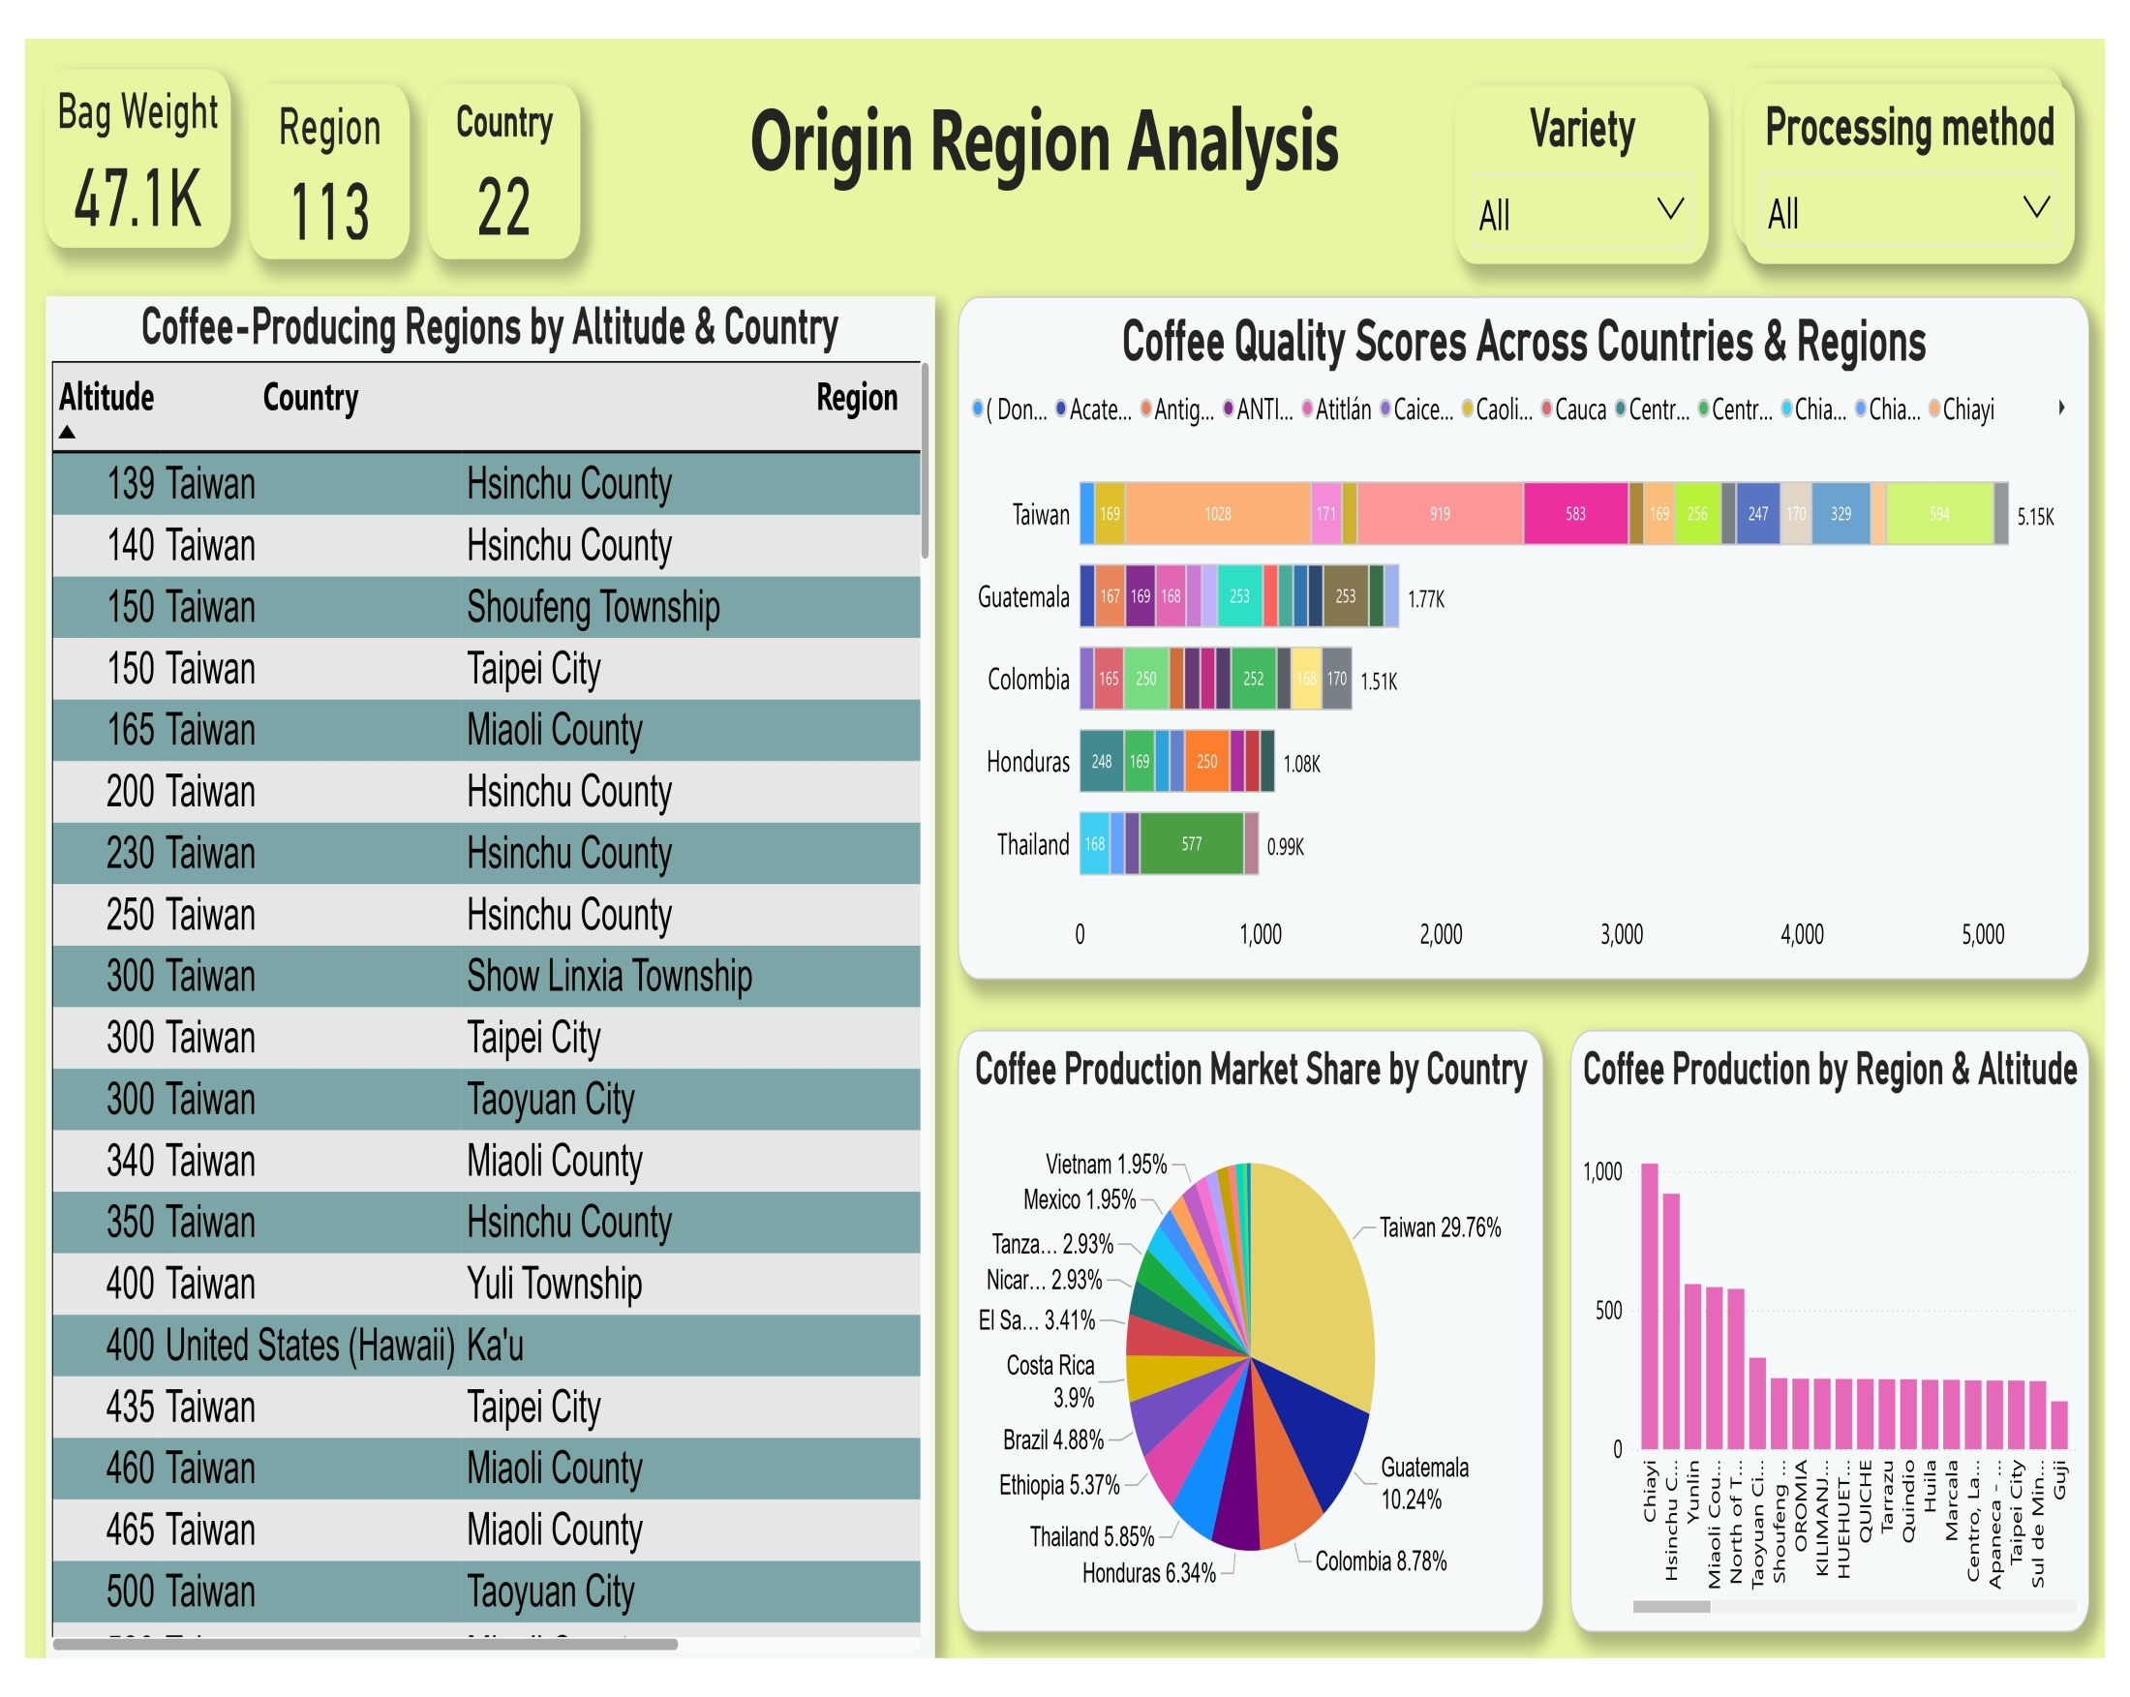

Slide 29
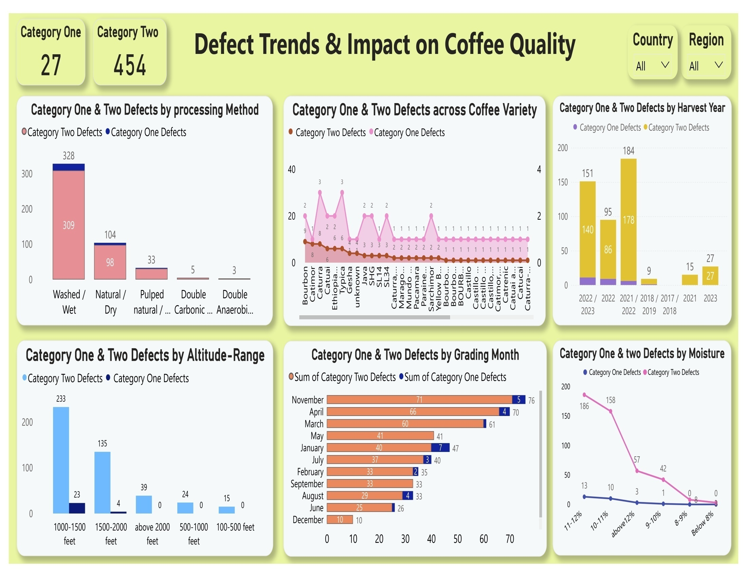

Slide 30
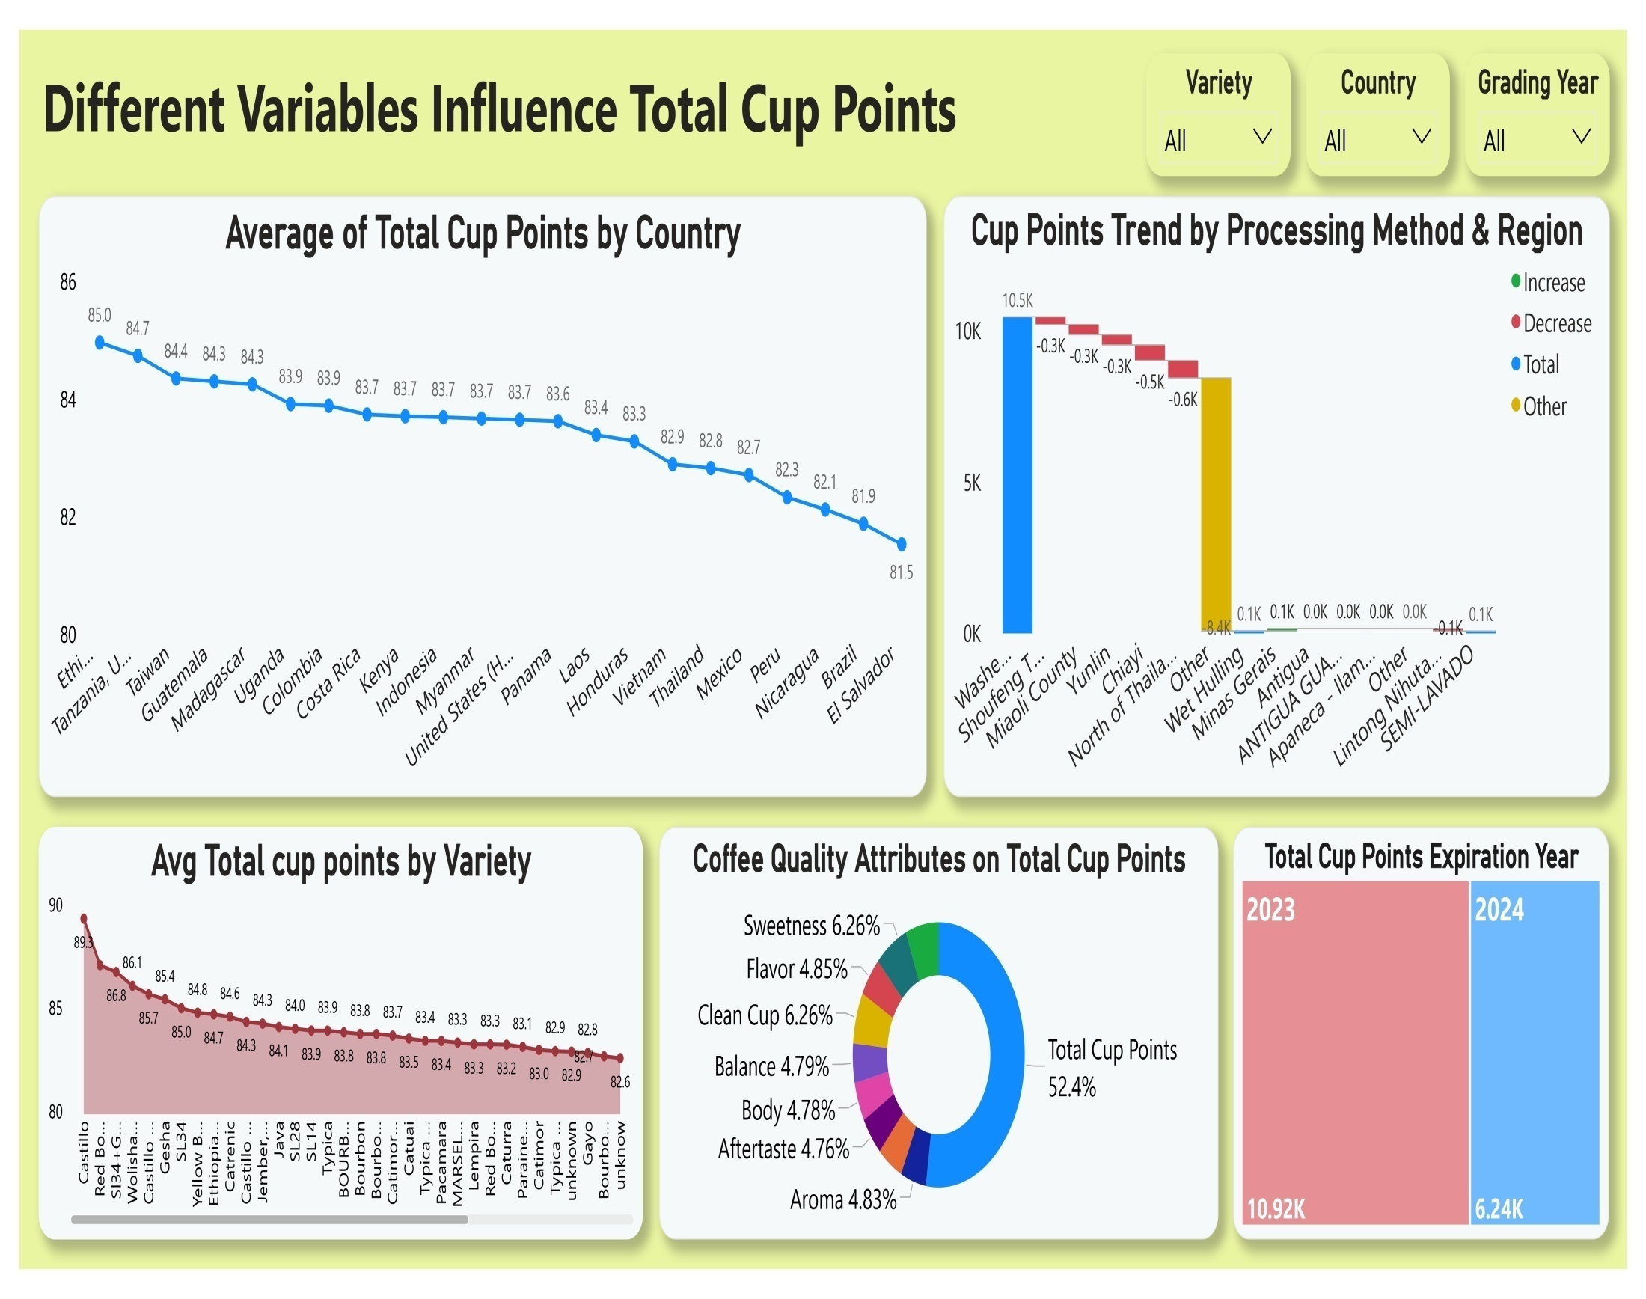

Slide 31
Insights
Outcome Of Projecct

Slide 32
Insights :
What are the key determinants of coffee quality as evaluated through sensory attributes such as aroma, flavour, acidity, etc.?
Uniformity & Clean Cup contribute the highest percentage, indicating their strong influence on coffee quality.
Aroma , flavour, acidity, body ,balance aftertaste are the key attributes that impacts on coffee quality
Bean varieties like Castillo and Red Bourbon tend to produce higher-quality coffee.
Processing methods impact sensory scores, with Washed and Natural methods yielding high-quality coffee.
Coffee quality is highest between 1200-1600m, but declines above 1600m.

Slide 33
Insights :
Is there a correlation between processing methods, origin regions, and coffee quality scores?
Washed/Wet is the most used method, while Anaerobic has the least usage.
Washed/Wet in North Thailand has the highest, while the lowest is in Pulped Natural in Miaoli County.
The country Taiwan has the highest cup points , while Anaerobic 1has the lowest.
Washed/Wet has the highest cup points and bag count, while Anaerobic contributes the least.
The Region Cauca has the highest average cup points, while El Salvador has the lowest.
Chiayi and Hsinchu County have the highest coffee production at higher altitudes, while lower-altitude regions contribute less.

Slide 34
Insights :
Can we identify any trends or patterns in defect occurrences and their impact on overall coffee quality?
Washed/Wet processed beans has more defects.
Bourbon, Caturra, and Typica varieties have more defects
Harvest Year 2021/2022 & 2022/2023 has more defected beans
Higher defects are recorded at 1000-1500 feet, which means altitude affects quality.
November, April & March Graded beans has more defects.
Beans with Moisture Range more than 10% has more defects .
Category 2 defects are more compared to category 1 defects.

Slide 35
Insights :
How do different variables interact to influence the Total Cup Points, which represent an overall measure of coffee quality?
Ethiopia, Tanzania, Taiwan, Gautemela, Madagasarcar are the top 5 Countries.
Castillo, Red Bourbon & SI34 +Gesha are top 3 quality beans when compared to Cup Points.
The overall Cup points of a coffee is influenced by attributes Acidity, Flavour, Aroma, Body, Balance, After taste. The increase in this attributes enchances the Coffee quality points.
The Washed/Wet process contributes the most cup points, especially in Miaoli country, Taiwan.

Slide 36
Suggestions for Future Research
Processing Method Optimization: Further research into the specific steps and conditions of high-performing processing methods like “Double Anaerobic Washed” can provide detailed guidelines for producers looking to adopt these techniques.
Defect Reduction Strategies: Investigating the root causes of defects and developing targeted interventions can help reduce the incidence of defects and improve overall coffee quality.
Consumer Preferences: Understanding consumer preferences for different sensory attributes can help producers tailor their products to meet market demands, thereby increasing satisfaction and market share.
Sustainability Practices: Exploring the relationship between sustainable farming practices and coffee quality can highlight the benefits of environmentally friendly methods, encouraging wider adoption.

Slide 37
Conclusion :
This data analytics project, using Power BI, uncovers valuable insights into the factors that drive coffee quality, from processing methods to defect management. By focusing on these key variables, businesses can make more informed decisions that enhance coffee quality and streamline their supply chains. The findings from this analysis offer a clear path forward for improving quality control and operational efficiency in the global coffee market.

Slide 38
Thank You
A . Archana

